Slide 1
Electronics Systems (938II)
Lecture 3.7
Semiconductor Memories – Computer memory

Slide 2
Summary of semiconductor memories*
So far, we have seen several semiconductor memories, each with advantages and disadvantages over the others
Register/DFF
ROM/PROM/EPROM/EEPROM/Flash
SRAM
DRAM

Slide 3
Summary of semiconductor memories*
Let’s compare them
Memory technology | Cost* (T) | Speed (Delay) | Other
DFF | 10T – 20T | Very high (10 ps) | Volatile
SRAM | 4T – 6T | High (1-10 ns) | Volatile
DRAM | ≈1T | Medium (100 ns) | Volatile
Flash | 1T | Slow (100 μs) | Non-volatile
* T = Transistors

Slide 4
Summary of semiconductor memories*
All the analyzed memory technologies are used in modern computers/computing systems for different purposes
Let’s take a look at modern computer memories

Slide 5
Computer memory*
Hierarchical organization
Each level interacts only with the higher one (if any) and the lower one (if any)
CPU
Register
Cache
(L1, L2, L3)
Main Memory
(“RAM”)
Persistent Storage
(Solid State Disk, SSD)

Slide 6
Computer memory*
Hierarchical organization
On-chip
CPU
Register
Cache
(L1, L2, L3)
Main Memory
(“RAM”)
Persistent Storage
(Solid State Disk, SSD)
Off-chip

Slide 7
Computer memory*
Hierarchical organization
Capacity
Cost
Density
Speed
Latency
CPU
Register
Cache
(L1, L2, L3)
Main Memory
(“RAM”)
Persistent Storage
(Solid State Disk, SSD)

Slide 8
Computer memory*
Hierarchical organization
Capacity
Cost
Density
Speed
Latency
CPU
Register
Register
Cache
(L1, L2, L3)
Main Memory
(“RAM”)
Persistent Storage
(Solid State Disk, SSD)

Slide 9
Computer memory*
Hierarchical organization
Capacity
Cost
Density
Speed
Latency
CPU
Register
Register
Cache
(L1, L2, L3)
SRAM
Main Memory
(“RAM”)
Persistent Storage
(Solid State Disk, SSD)

Slide 10
Computer memory*
Hierarchical organization
Capacity
Cost
Density
Speed
Latency
CPU
Register
Register
Cache
(L1, L2, L3)
SRAM
Main Memory
(“RAM”)
DRAM
Persistent Storage
(Solid State Disk, SSD)

Slide 11
Computer memory*
Hierarchical organization
Capacity
Cost
Density
Speed
Latency
CPU
Register
Register
Cache
(L1, L2, L3)
SRAM
Main Memory
(“RAM”)
DRAM
Persistent Storage
(Solid State Disk, SSD)
Flash

Slide 12
Computer memory*
Summary
Computer Memory | CMOS Memory technology | Capacity | Latency | Cost/GB | Position
CPU registers | Register | 1 Kb | Very low (10 ps) | $$$$ | On-chip
Cache | SRAM | 1 KB – 10 MB | Medium-low (1-10 ns) | 100 – 1000 $ | On-chip
Main Memory | DRAM | 1 GB – 10 GB | Medium (100 ns) | 4 – 5 $ | Off-chip
Storage/SSD | Flash | 100 GB – 1 TB | Very High (100 μs) | 0.1 S | Off-chip

Slide 13
Exercise with SystemVerilog
Implementation of RAM/ROM (model) and simulation with Modelsim

Slide 14
Exercise with SystemVerilog
Implementation of RAM/ROM (model) and simulation with Modelsim
Often, RAM (Main Memory) and ROM are used in the HDL design flow as just model for simulation
Otherwise, if they are used for memory implementation, they require special and dedicated steps in the design flow
E.g., Memory Compiler automation tools

Slide 15
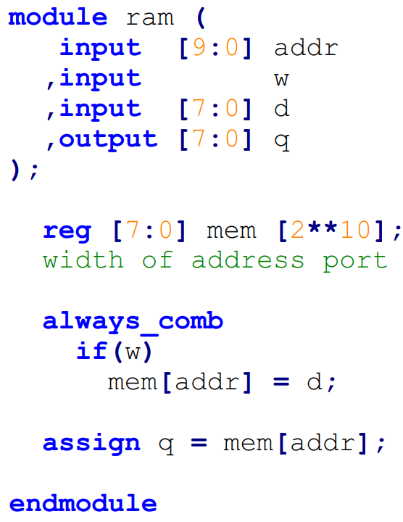
Exercise with SystemVerilog
Implementation of RAM/ROM (model) and simulation with Modelsim
RAM

Slide 16
Exercise with SystemVerilog
Implementation of RAM/ROM (model) and simulation with Modelsim
RAM
Ports
Address
Write/Read command
Input data (D)
Output data (Q)

Slide 17
Exercise with SystemVerilog
Implementation of RAM/ROM (model) and simulation with Modelsim
RAM
Ports
Address
Write/Read command
Input data (D)
Output data (Q)

Slide 18
Exercise with SystemVerilog
Implementation of RAM/ROM (model) and simulation with Modelsim
RAM
Ports
Address
Write/Read command
Input data (D)
Output data (Q)
Memory shape
Assume data width = B
Assume address bit = N → 2^{N} cells
Shape = 2^{N} × B

Slide 19





Exercise with SystemVerilog
Implementation of RAM/ROM (model) and simulation with Modelsim
RAM
Ports
Address
Write/Read command
Input data (D)
Output data (Q)
Memory shape
Assume data width = B
Assume address bit = N → 2^{N} cells
Shape = 2^{N} × B

Slide 20
Exercise with SystemVerilog
Implementation of RAM/ROM (model) and simulation with Modelsim
RAM
Ports
Address
Write/Read command
Input data (D)
Output data (Q)
Memory shape
Assume data width = B
Assume address bit = N → 2^{N} cells
Shape = 2^{N} × B
In this example
B = 8 ← [7:0] d , [7:0] q
N = 10 ← [9:0] addr

Slide 21
Exercise with SystemVerilog
Implementation of RAM/ROM (model) and simulation with Modelsim
RAM
Ports
Address
Write/Read command
Input data (D)
Output data (Q)
Memory shape
Assume data width = B
Assume address bit = N → 2^{N} cells
Shape = 2^{N} × B
In this example
B = 8 ← [7:0] d , [7:0] q
N = 10 ← [9:0] addr

Slide 22
Exercise with SystemVerilog
Implementation of RAM/ROM (model) and simulation with Modelsim
RAM
Packed/Unpacked arrays
Packed dimension : before signal name (the one seen so far)
Unpacked dimension : after signal name

Slide 23


Exercise with SystemVerilog
Implementation of RAM/ROM (model) and simulation with Modelsim
RAM
Packed/Unpacked arrays
Packed dimension : before signal name (the one seen so far)
Unpacked dimension : after signal name
Both optional and both without limitations
Multiple dimensions of both kinds can be specified
If only packed dimension(s) → packed array
If only unpacked dimension(s) → unpacked array
If both → mixed packed/unpacked array

Slide 24
Exercise with SystemVerilog
Implementation of RAM/ROM (model) and simulation with Modelsim
RAM
Packed/Unpacked arrays
Packed array
Contiguous groups of bits
Just a smart organization
Examples:
reg [7:0] a
reg [2:0] [3:0] b

Slide 25
Exercise with SystemVerilog
Implementation of RAM/ROM (model) and simulation with Modelsim
RAM
Packed/Unpacked arrays
Unpacked array
Non-contiguous groups of bits
Examples:
wire a [3:0]
reg b [8]

Slide 26


Exercise with SystemVerilog
Implementation of RAM/ROM (model) and simulation with Modelsim
RAM
Packed/Unpacked arrays
In this example

Slide 27
Exercise with SystemVerilog
Implementation of RAM/ROM (model) and simulation with Modelsim
RAM
Packed/Unpacked arrays
Multidimensional packed/unpacked arrays
Access following the order of unpacked dimensions (left to right) then packed dimensions (left to right)
Example:
reg [3:0][7:0] foo [8][24];
foo[7][23][3][7];
Access in this order: [8] → [24] → [3:0] → [7:0]

Slide 28





Exercise with SystemVerilog
Implementation of RAM/ROM (model) and simulation with Modelsim
RAM
Write logic
Read logic

Slide 29
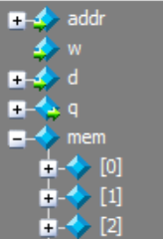

Exercise with SystemVerilog
Implementation of RAM/ROM (model) and simulation with Modelsim
RAM
Simulation example
…

Slide 30
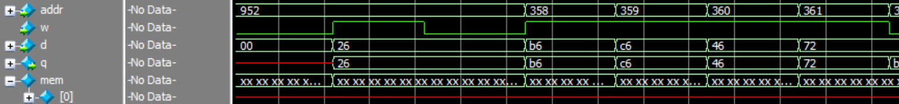
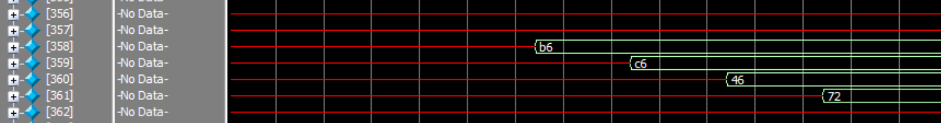
Exercise with SystemVerilog
Implementation of RAM/ROM (model) and simulation with Modelsim
RAM
Simulation example
Write some locations and check by
Visual inspection of waveform
Reading and displaying written value
…
…
…

Slide 31
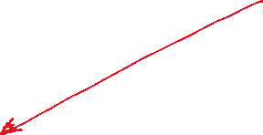
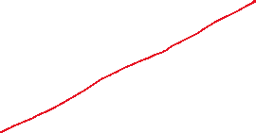


Exercise with SystemVerilog
Implementation of RAM/ROM (model) and simulation with Modelsim
RAM
Simulation example
Write some locations and check by
Visual inspection of waveform
Reading and displaying written value
…
…
…

Slide 32
Exercise with SystemVerilog
Implementation of RAM/ROM (model) and simulation with Modelsim
ROM
Similar to RAM but
Without input data (D)
Without write/Read command
Only read logic

Slide 33
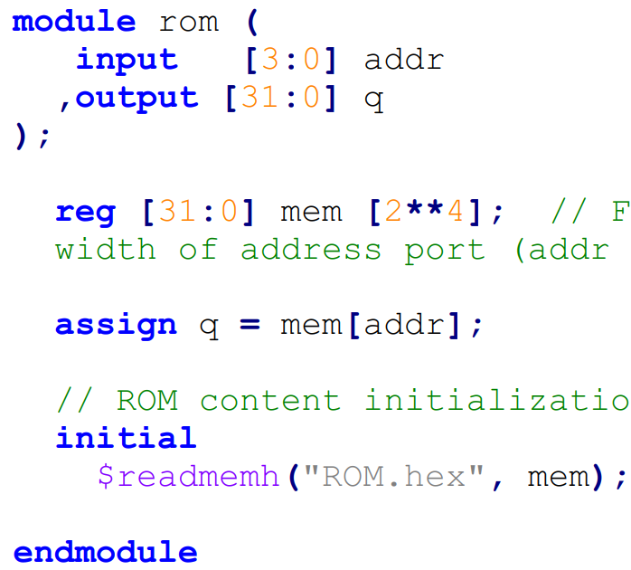
Exercise with SystemVerilog
Implementation of RAM/ROM (model) and simulation with Modelsim
ROM
Similar to RAM but
Without input data (D)
Without write/Read command
Only read logic

Slide 34
Exercise with SystemVerilog
Implementation of RAM/ROM (model) and simulation with Modelsim
ROM
Similar to RAM but
Without input data (D)
Without write/Read command
Only read logic
But how to “write” content? In other words, how to initialize content of the ROM?

Slide 35
Exercise with SystemVerilog
Implementation of RAM/ROM (model) and simulation with Modelsim
ROM
Similar to RAM but
Without input data (D)
Without write/Read command
Only read logic
But how to “write” content? In other words, how to initialize content of the ROM?
readmem command (+ initial block)

Slide 36
Exercise with SystemVerilog
Implementation of RAM/ROM (model) and simulation with Modelsim
ROM
Similar to RAM but
Without input data (D)
Without write/Read command
Only read logic
But how to “write” content? In other words, how to initialize content of the ROM?
readmem command (+ initial block)
$readmemh/$readmemb(“file path”, <memory variable>)

Slide 37


Exercise with SystemVerilog
Implementation of RAM/ROM (model) and simulation with Modelsim
ROM
Similar to RAM but
Without input data (D)
Without write/Read command
Only read logic
But how to “write” content? In other words, how to initialize content of the ROM?
readmem command (+ initial block)
$readmemh/$readmemb(“file path”, <memory variable>)
$readmemh if digits in file are hexadecimal
$readmemb if digits in file are binary

Slide 38
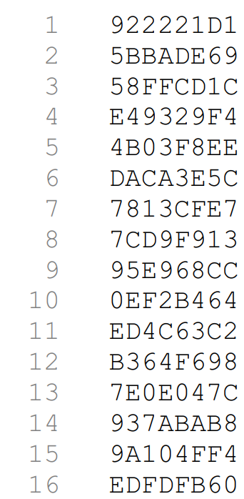
Exercise with SystemVerilog
Implementation of RAM/ROM (model) and simulation with Modelsim
ROM
File content
Example (“ROM.hex”)

Slide 39

Exercise with SystemVerilog
Implementation of RAM/ROM (model) and simulation with Modelsim
ROM
File content
Example (“ROM.hex”)
Same bit width per line

Slide 40

Exercise with SystemVerilog
Implementation of RAM/ROM (model) and simulation with Modelsim
ROM
File content
Example (“ROM.hex”)
Same bit width per line
Each line = one address

Slide 41
Exercise with SystemVerilog
Implementation of RAM/ROM (model) and simulation with Modelsim
ROM
ROM initialization inside an initial block
This is not synthesizable
This approach can be used only for modelling ROM
Synthesizable-code approaches available, but omitted for simplicity

Slide 42
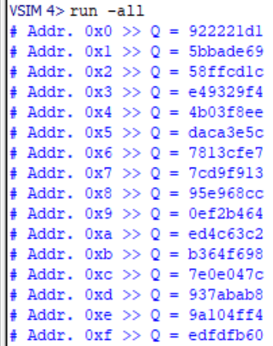
Exercise with SystemVerilog
Implementation of RAM/ROM (model) and simulation with Modelsim
ROM
Simulation example
Read each address and display value to manually check against the content of initialization file

Slide 43
Exercise with SystemVerilog
Implementation of RAM/ROM (model) and simulation with Modelsim
You can find all the files about this exercise in the dedicated folder on the Team of the course
File > Electronics Systems module > Crocetti > Exercises > 3.7
‘ram’ sub-folder, for RAM-related SV files
‘rom’ sub-folder, for ROM-related SV files
Try to design and simulate on your own
An example of ROM initialization file in ‘rom > ROM.hex’

